Slide 1
Types of Database
Database Systems
Notes:
Database Systems (Spring 2011) - Naveed Anwer Butt @UOG

Slide 2
Session Objectives
Types of Database
  Centralized Database
  Personal Computer Database
  Client/Server database
  Distributed Database
    Homogeneous Distributed Database
    Heterogeneous Distributed Database
Teleprocessing

Slide 3
Roles in the Database Environment
Data Administrator (DA)
Database Administrator (DBA)
Database Designers (Logical and Physical)
Application Programmers
End Users (naive and sophisticated)

Slide 4
What do you want from a DBMS?
Answer queries (questions) about data
Update data
And keep data around (Persistent)
Example: A traditional banking application
Each account belongs to a branch, has a number, an owner, a balance,……
Query: What’s the balance in Ali Traders account?
Modification: Ali traders withdraws 1000 Rs.
Persistency: Ali will be pretty upset if his balance disappears after power outage

Slide 5

Some Recent Trends
DBMS are getting smaller and smaller
  DBMS that can store GB of data can run on PC
Databases are getting bigger and bigger
  Multiple TBs (terabyte = 1012 bytes) not uncommon
  Databases also able to store images, video, audio
  Database stored on secondary storage devices
DBMS Supporting Parallel Computing
  Speed-up query processing through parallelism (e.g., read data from many disks)
  However, need special algorithms to partition data correctly

Slide 6
When NOT to Use a DBMS
Initial investment too high
Too much overhead
Application is simple, well-defined, not expected to change
Multi-user access to data is not required

Slide 7
Types of DBMS
General-purpose DBMS: can store and accessed is either textual or numeric
Multimedia DBMS: can now store pictures, video clips, and sound messages.
Geographic information systems (GIS): can store and analyze maps, weather data, and satellite images.
Data warehouse& OLAP DBMS: systems are used in many companies to extract and analyze useful information from very large databases for decision making.
Real-time DBMS: and active database technology is used in controlling industrial and manufacturing processes.

Slide 8

Types of Databases
Several strategies are available for deploying and using databases in organizations.
There are two generic database architectures:
Centralized
Distributed

Slide 9
Central Computer Database
“ If collection of data or facts are stored at single side is called centralized database.”
There are three common examples of centralized databases:
A Personal computer database
A central computer database
A Client/Server database

Slide 10
Personal Computer Database
“Single user database, which is used by single user. “
Common Applications:
Simple accounting system
Inventory used in small scale business

Slide 11
Central Computer Database
The Data that most applications in large organizations access is stored on a central computer. Depending on the size of the organization, the central computer is usually a mainframe or a minicomputer. Central computer database often involve very large, integrated databases that must be accessed by a large number of users. Usage is often intense, with several hundred transactions per second being processed.

Slide 12
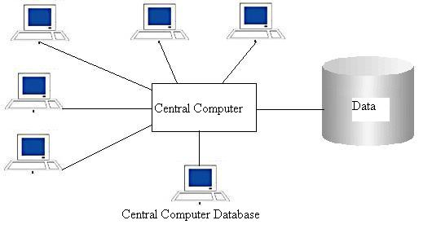
Common Applications:
Airline reservation systems
Financial institutions
Express delivery companies

Slide 13
Client/Server Database
“Client / Server architecture is designed for the distribution of work on a computer network in which many clients may share the services of a single server.”
Client/Server architecture has three components
Client
Server
Network

Slide 14
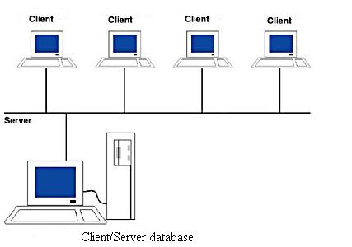
Client/Server Environment

Slide 15
Benefits
Many clients can share resources
Clients’ applications can be designed with no dependency on the physical location of data.
Essay to manage concurrent access
Provide independence between applications components and reduce costs.

Slide 16
Distributed Database
“Distributed database system is a set of database stored on more than one CPU in such a way that users precise the data as a single large database where as infect it is several smaller database.”
“A distributed database is a single logical database that spread physically across computer in multiple locations”

Slide 17
Categories of Distributed Databases
“ When applied to databases, the term homogeneous means that the database technology is the same (or at least compatible) at each locations and that the data at various locations are also compatible “
The following conditions would probable exist:
The computer operating systems used at each of the locations are the same, or at least they are highly compatible
The data models used at each of the locations are the same.
The database management systems used at each locations are the same, or at least they are highly compatible .
The data at the various locations have common definitions and formats.

Slide 18
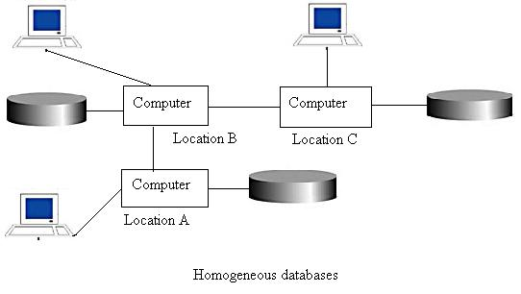
Homogeneous Databases

Slide 19
Heterogeneous Database
“When applied to databases, the term heterogeneous means that the database technology is not same at each locations and that the data at various locations are also not compatible “

Slide 20
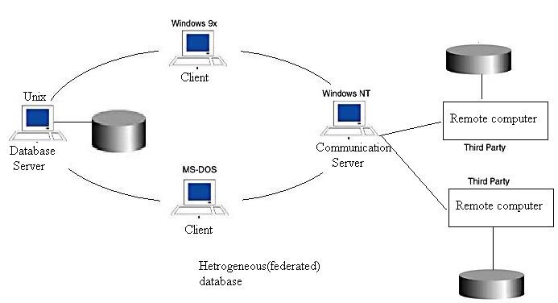
Heterogeneous Database

Slide 21
The Range of
Database Applications
Personal Database – standalone desktop database
Workgroup Database – local area network (<25 users)
Department Database – local area network (25-100 users)
Enterprise Database – wide-area network (hundreds or thousands of users)

Slide 22
Evolution of DB Systems
Flat files - 1960s - 1980s
Hierarchical – 1970s - 1990s
Network – 1970s - 1990s
Relational – 1980s - present
Object-oriented – 1990s - present
Object-relational – 1990s - present
Data warehousing – 1980s - present
Web-enabled – 1990s - present

Slide 23
History of Database Systems
First-generation
  Hierarchical and Network
Second generation
  Relational
Third generation
  Object-Relational
  Object-Oriented

